Slide 1
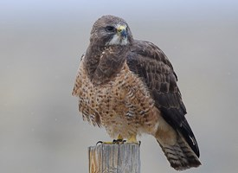
Save the Swanson's Hawks at NMSU
David M. Boje

Slide 2
Hawks are Agile Can NMSU be Agile too?

Slide 3
3H’s: Hawk-Habitat-Human
Hawk and Human are in a struggle over the NMSU Habitat (nest, tree).
In today’s world, a Hegel approach is emerging, where the 3H’s dialectical realationships can be reimagined.
The new struggle is between baby Hawks and Humans on their cell phones, oblivious to organic Nature, and how to coexist with Nature.

Slide 4
Notes:
https://socioecons.wordpress.com/page/2/

Slide 5
NMSU Works to Discourage Hawks nesting
http://www.washingtontimes.com/news/2016/apr/16/nmsu-works-to-discourage-hawks-from-nesting-on-cam/
Sun-News story
“For a third consecutive year Swainson’s hawks are trying to nest in a tree on campus, The Las Cruces Sun-News reported (http://bit.ly/1MzVEeK). If the hawks are able to form an active nest with at least one egg or if there are nestlings, federal law prevents university officials from removing the birds.”

Slide 6
The struggle of Hawk and Human over Habitat (nest)
“Delivan J. Roper, a special agent with the Fish and Wildlife Service, said Tuesday in an email to Haubold that biologists have recommended the university remove nests that are being constructed before eggs are laid in order to deter the hawks from using the populated location. He said the university also could apply for a permit to have the hawks captured and removed” – Sun News quote http://www.washingtontimes.com/news/2016/apr/16/nmsu-works-to-discourage-hawks-from-nesting-on-cam/

Slide 7
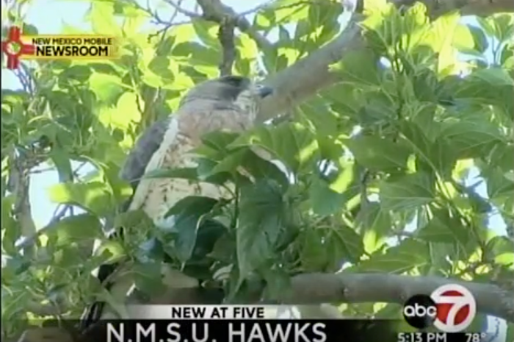
What’s NMSU storytelling about its Hawks?
https://www.youtube.com/watch?v=xVdPDrBg-HQ

Slide 8
The Dialectic of Hawk-Habitat-Human at NMSU
Hegel’s idea is not totality as ‘organic whole’ and its ‘hidden harmony’ but rather to see the self-contradictory aspects of its parts, its unintended consequences, e.g. What are the unintended consequences of today’s capitalism and university on the Hawk’s spacetime of its species survival?
https://www.youtube.com/watch?v=Fidb5QHX7ME
The excesses of unsustainability undermine the Hawk’s survival; Every project to contain/control the Hawk is undermined by its inconsistency. – from Zizek

Slide 9
What is Cornell University’s Storytelling of its Hawks
https://www.youtube.com/watch?v=jzmfB7Yna04
Why can Cornel University get along with its Hawks but NMSU is so unable to just get along and co-exist in same Habitat?

Slide 10
It takes about 8 weeks and then Hawks move on
https://www.youtube.com/watch?v=fx6mfBpsdJk
This storytelling from a Florida neighborhood
What is the difference between a Research University and a Florida suburb?

Slide 11
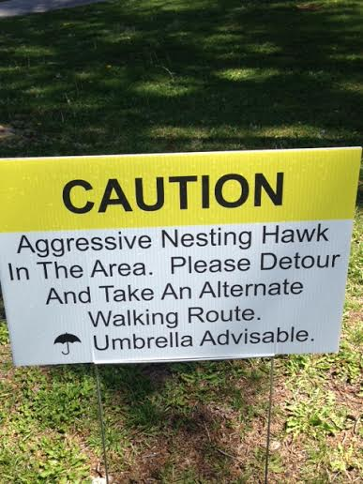

Slide 12
We are not thinking in Hegelian Dialectic
I want to critically equation the way we are observing and considering the problem
In what way are we perceiving the problem
Is i correct to just treat it as a problem of chainsaw the nests of Hawks
In ecology we are approaching a spacetime when critical questioning is necessary
We need to change the definition of being Human with Hawk in shared Habitat
The state of emergency storytelling is Hawk is attacking Human, but the reverse of this storytelling is Human is attacking Hawk’s survival as species, here and globally.
The message of the signs is don’t think about the species versus species issue.
The signs do a wonderful job of ideology. Fear, and proposing umbrella as only option.
The message again is don’t think, be afraid of Hawk, and know they are Dangerous and Aggressive

Slide 13
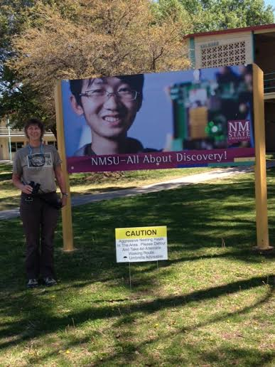

Slide 14
Hegel’s Dialectic of Organic Unity of Being & Action
Hegel first to talk of when Human and Nature relations go wrong. Why is this happening? Humans think they are something special, more special than Hawk or its Habitat, which is only valued as Human habitat. When we observe the situation at NMSU Hawk-Habitat-Human we can see the sacrifice of Hawk and its Habitat as the dominate of Human over the Habitat. Human is unable or unwilling to live in Nature with Hawk, to share Habitat with Hawk.

Slide 15
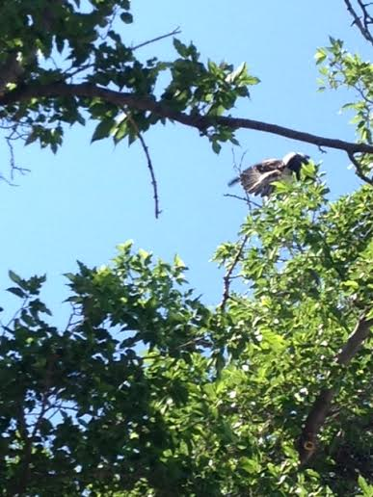

Slide 16
Can we just get along?
Kevin Bixby of SWEC said, “Apart from the fact that they broke the law, they didn't deal with the problem, because the hawks will keep nesting there. They should have seen this as a teaching opportunity. There were a lot of things they could have done to coexist. Instead of what they did, they could have made national news as an innovative institution. We have to learn to coexist with nature.”

Slide 17
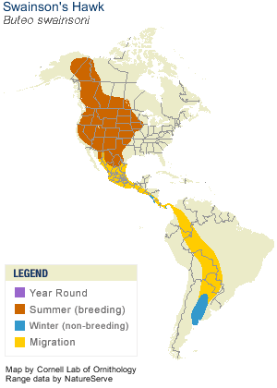
These elegant gray, white, and brown hawks hunt rodents in flight, wings held in a shallow V, or even run after insects on the ground. In fall, they take off for Argentine wintering grounds—one of the longest migrations of any American raptor—forming flocks of hundreds or thousands as they travel.

Slide 18
Can Hawks & Human co-exist?
Vice President for Facilities Glen Haubold expressed concern for both birds and humans, and the intention to find a way to coexist. He sounded thoughtful and prudent. He said that some of the injuries last year were serious, and that there's a particular danger when the fledglings land near the swimming pool, where human kids play. (The hawks think it all belongs to them.) He said NMSU was working to harmonize the needs of birds and people.

Slide 19
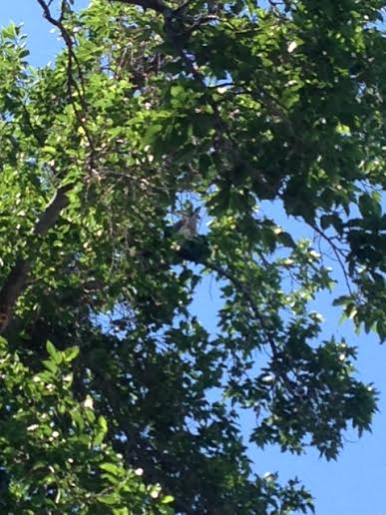

Slide 20
The Law says…
All species of hawks are protected under the Migratory Bird Treaty Act and it is illegal to harm, harass or kill them.
I'd sure say NMSU is harassing two hawks -- and arguably harming them.
But a further conversation (after this column had been set) with Enforcement Agent Roper confirmed that the FWS's position is that what NMSU is doing is legal.
It also appears that NMSU has contacted FWS about a permit to do more. That would likely involve moving the hawks, which would be done by an expert, not by NMSU itself; and it could even allow NMSU to kill the hawks, although NMSU's Tom Dobson told me Friday afternoon that "destoying the birds is not an option that we're even pursuing."

Slide 21
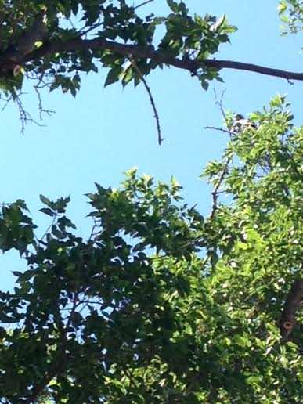

Slide 22
NESTING
In courtship, members of pair engage in display flights, with circling and steep dives. On prairies with scattered groves of trees, may have conflicts with Great Horned Owl where both species attempt to nest in same grove. Nest site is usually in a tree or large shrub in open country, usually 15-30' above ground,

Slide 23
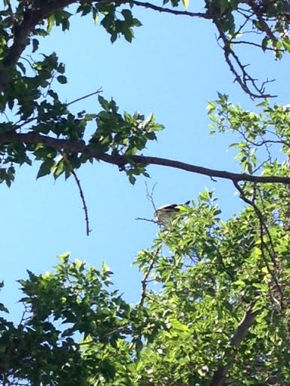

Slide 24
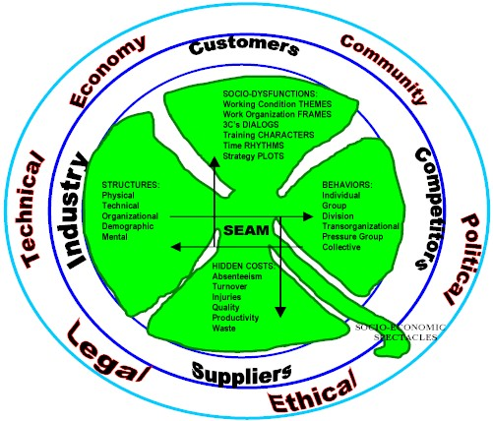
HOW SEAM APPLIES

Slide 26
Can Human and Hawk share NMSU Habitat?
All species of hawks are protected under the Migratory Bird Treaty Act and it is illegal to harm, harass or kill them.
I'd sure say NMSU is harassing two hawks -- and arguably harming them.
…position is that what NMSU is doing is legal.
It also appears that NMSU has contacted FWS about a permit to do more. That would likely involve moving the hawks, which would be done by an expert, not by NMSU itself; and it could even allow NMSU to kill the hawks, although NMSU's Tom Dobson told me Friday afternoon that "destoying the birds is not an option that we're even pursuing.”

